Slide 1
Java Programming, 9e Chapter 1
Creating Java Programs

Slide 2
Objectives
Upon completion of this chapter you will be able to:
Define basic programming terminology
Compare procedural and object-oriented programming
Describe the features of the Java programming language
Analyze a Java application that produces console output
Compile a Java class and correct syntax errors
Run a Java application and correct logic errors
Add comments to a Java class
Create a Java application that produces GUI output
Find help

Slide 3
Learning Programming Terminology (1 of 3)
Computer program
A set of written instructions that tells the computer what to do
Machine language
The most basic circuitry-level language
A low-level programming language

Slide 4
Learning Programming Terminology (2 of 3)
High-level programming language
Allows you to use a vocabulary of reasonable terms
Syntax
A specific set of rules for the language
Program statements
Similar to English sentences
Commands to carry out program tasks

Slide 5
Learning Programming Terminology (3 of 3)
Compiler or interpreter
Translates language statements into machine code
Syntax error
Misuse of language rules
A misspelled programming language word
Debugging
Freeing program of all errors
Logic errors
Also called semantic errors
Incorrect order or procedure
The program may run but provide inaccurate output

Slide 6
Comparing Procedural and Object-Oriented Programming Concepts (1 of 2)
Procedural programming
Sets of operations executed in sequence
Variables
Named computer memory locations that hold values
Procedures
Individual operations grouped into logical units
Object-oriented programs
Create classes
Blueprints for an object
Create objects from classes
Create applications

Slide 7
Comparing Procedural and Object-Oriented Programming Concepts (2 of 2)
Object-oriented programming was used most frequently for two major types of applications
Computer simulations
Graphical user interfaces (GUIs)
Not all object-oriented programs are written to use a GUI
Object-oriented programming differs from traditional procedural programming
Polymorphism
Inheritance
Encapsulation

Slide 8
Understanding Classes, Objects, and Encapsulation (1 of 3)
Class
Describes objects with common properties
A definition
An instance
Attributes
Characteristics that define an object
Differentiate objects of the same class
The value of attributes is an object’s state
Objects
Specific, concrete instances of a class

Slide 9
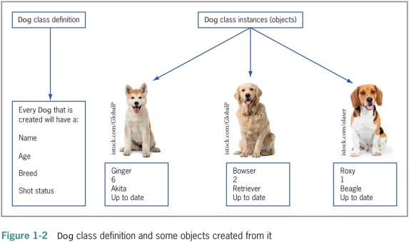
Understanding Classes, Objects, and Encapsulation (2 of 3)

Slide 10
Understanding Classes, Objects, and Encapsulation (3 of 3)
Method
A self-contained block of program code that carries out an action
Similar to a procedure
Encapsulation
Conceals internal values and methods from outside sources
Provides security
Keeps data and methods safe from inadvertent changes

Slide 11
Understanding Inheritance and Polymorphism
Inheritance
An important feature of object-oriented programs
Classes share attributes and methods of existing classes but with more specific features
Helps you understand real-world objects
Polymorphism
Means “many forms”
Allows the same word to be interpreted correctly in different situations based on context

Slide 12
Features of the Java Programming Language (1 of 5)
Java
Developed by Sun Microsystems
An object-oriented language
General-purpose
Advantages
Security features
Architecturally neutral

Slide 13
Features of the Java Programming Language (2 of 5)
Java (cont’d.)
Can be run on a wide variety of computers
Does not execute instructions on the computer directly
Runs on a hypothetical computer known as a Java Virtual Machine (JVM)
Source code
Programming statements written in high-level programming language

Slide 14
Features of the Java Programming Language (3 of 5)
Development environment
A set of tools used to write programs
Bytecode
Statements saved in a file
A binary program into which the Java compiler converts source code
Java interpreter
Checks bytecode and communicates with the operating system
Executes bytecode instructions line by line within the Java Virtual Machine

Slide 15
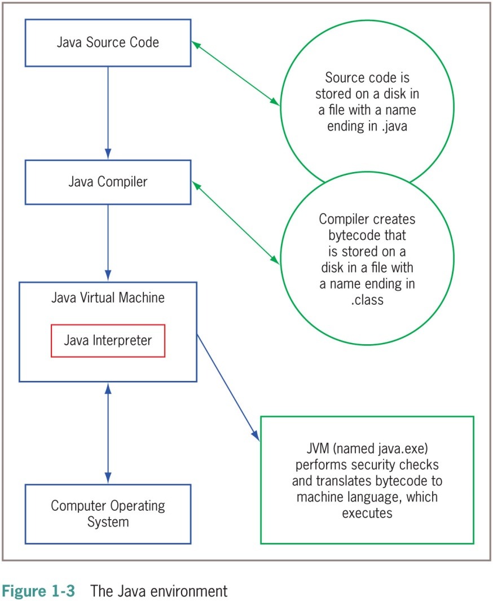
Features of the Java Programming Language (4 of 5)

Slide 16
Features of the Java Programming Language (5 of 5)
WORA
Write once, run anywhere
Console applications
Support character output
Windowed applications
Menus
Toolbars
Dialog boxes

Slide 17
Analyzing a Java Application that Produces Console Output (1 of 2)
Even the simplest Java application involves a fair amount of confusing syntax
Print “First Java application” on the screen

Slide 18
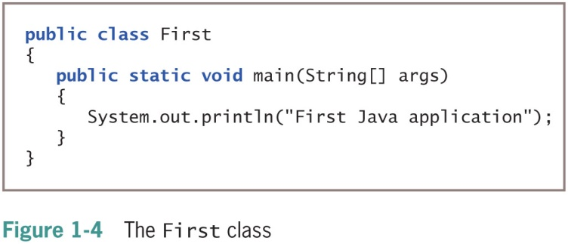
Analyzing a Java Application that Produces Console Output (2 of 2)

Slide 19
Understanding the Statement that Produces the Output (1 of 2)
Literal string
Will appear in output exactly as entered
Written between double quotation marks
Arguments
Pieces of information passed to a method
Method
Requires information to perform its task
System class
Refers to the standard output device for a system

Slide 20
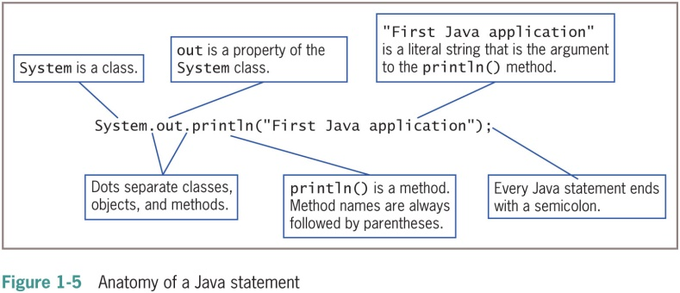
Understanding the Statement that Produces the Output (2 of 2)

Slide 21
Understanding the First Class (1 of 6)
Everything used within a Java program must be part of a class
Define a Java class using any name or identifier
Requirements for identifiers
Must begin with one of the following:
Letter of the English alphabet
Non-English letter (such as α or π)
Underscore
Dollar sign
Cannot begin with a digit

Slide 22
Understanding the First Class (2 of 6)
Requirements for identifiers (cont’d.)
Can only contain:
Letters
Digits
Underscores
Dollar signs
Cannot be a Java reserved keyword
Cannot be true, false, or null
Upper Camel casing (Pascal casing)
Each word of an identifier begins with uppercase letter
UnderGradStudent
InventoryItem
Access specifier
Defines how a class can be accessed

Slide 23
Understanding the First Class (3 of 6)
Table 1-1: Java reserved keywords
abstract | continue | for | new | switch
assert | default | got | package | synchronized
boolean | do | if | private | this
break | double | implements | protected | throw
byte | else | import | public | throws
case | enum | instanceof | return | transient
catch | extends | int | short | try
char | final | interface | static | void
class | finally | long | strictfp | volatile
const | float | native | super | while

Slide 24
Understanding the First Class (4 of 6)
Table 1-3: Legal but unconventional and nonrecommended class names in Java
Class Name | Description
Undergradstudent | New words are not indicated with initial uppercase letters, making this identifier difficult to read
Inventory_Item | Underscore is not commonly used to indicate new words
BUDGET2019 | Using all uppercase letters for class identifiers is not conventional
budget2019 | Conventionally, class names do not begin with a lowercase letter

Slide 25
Understanding the First Class (5 of 6)
Table 1-4: Some illegal class names in Java
Class Name | Description
Inventory Item | Space character is illegal in an identifier
class | class is a reserved word
2019Budget | Class names cannot begin with a digit
phone# | The number symbol (#) is illegal in an identifier

Slide 26
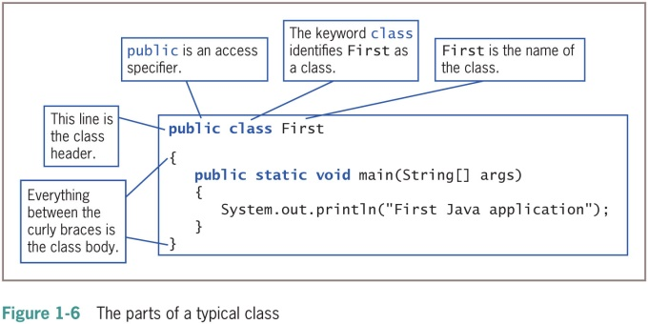
Understanding the First Class (6 of 6)

Slide 27
Understanding the main() Method (1 of 3)
static
A reserved keyword
Means the method is accessible and usable even though no objects of the class exist
void
Use in the main() method header
Does not indicate the main() method is empty
Indicates the main() method does not return a value when called
Does not mean that main() doesn’t produce output

Slide 28
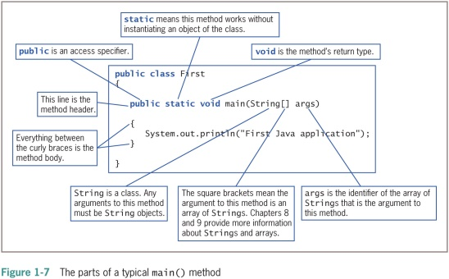
Understanding the main() Method (2 of 3)

Slide 29
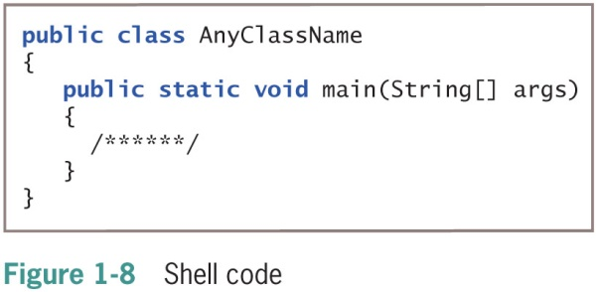
Understanding the main() Method (3 of 3)

Slide 30
Indent Style
Use whitespace to organize code and improve readability
For every opening curly brace ( { ) in a Java program, there must be a corresponding closing curly brace
( } )
Placement of the opening and closing curly braces is not important to the compiler
Allman style used in text

Slide 31
Saving a Java Class
Saving a Java class
Save the class in a file with exactly the same name and .java extension
For public classes, class name and filename must match exactly

Slide 32
Compiling a Java Class and Correcting Syntax Errors (1 of 2)
Compiling a Java class
Compile the source code into bytecode
Translate the bytecode into executable statements
Using a Java interpreter
Type javac First.java
Compilation outcomes
javac is an unrecognized command
Program language error messages
No messages indicating successful completion

Slide 33
Compiling a Java Class and Correcting Syntax Errors (2 of 2)
Reasons for error messages
Misspelled the command javac
A misspelled filename
Not within the correct subfolder or subdirectory on the command line
Improper installation of Java

Slide 34
Correcting Syntax Errors
The first line of the error message displays:
The name of the file where the error was found
The line number
The nature of the error
Next lines identify:
The symbol
The location
Compile-time error
The compiler detects a violation of language rules
Refuses to translate the class to machine code
Parsing
Compiler divides source code into meaningful portions

Slide 35
Running a Java Application and Correcting Logical Errors (1 of 2)
Run the application from the command line
Type java First
Shows the application’s output in the command window
The class is stored in a folder named Java on the C drive

Slide 36
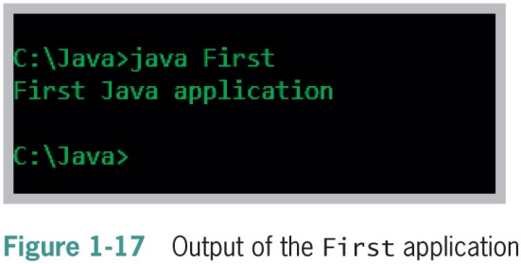
Running a Java Application and Correcting Logical Errors (2 of 2)

Slide 37
Modifying a Compiled Java Class (1 of 2)
Modify the text file that contains the existing class
Save the file with changes using the same filename
Compile the class with the javac command
Interpret the class bytecode and execute the class using the java command

Slide 38
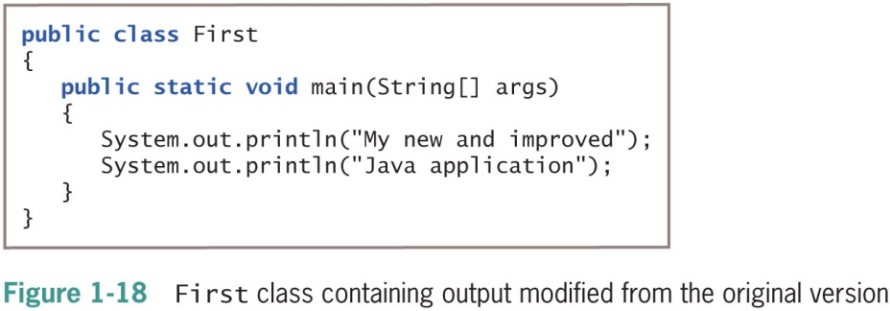
Modifying a Compiled Java Class (2 of 2)

Slide 39
Correcting Logic Errors
Logic error
The syntax is correct but incorrect results were produced when executed
Run-time error
Not detected until execution
Often difficult to find and resolve

Slide 40
Adding Comments to a Java Class (1 of 4)
Program comments
Nonexecuting statements added to a program for documentation
Use to leave notes for yourself or others
Include the author, date, and class’s name or function
Comment out a statement
Turn it into a comment
The compiler does not translate, and the JVM does not execute its command

Slide 41
Adding Comments to a Java Class (2 of 4)
Types of Java comments
Line comments
Start with two forward slashes (//)
Continue to the end of the current line
Do not require an ending symbol
Block comments
Start with a forward slash and an asterisk (/*)
End with an asterisk and a forward slash (*/)

Slide 42
Adding Comments to a Java Class (3 of 4)
Types of Java comments (cont’d.)
Javadoc comments
A special case of block comments
Begin with a slash and two asterisks (/**)
End with an asterisk and a forward slash (*/)
Use to generate documentation

Slide 43
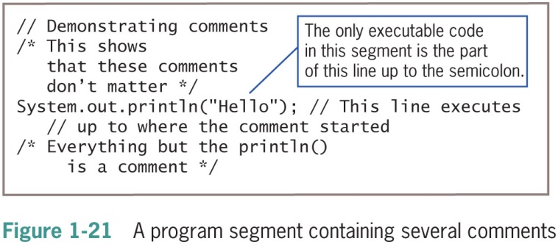
Adding Comments to a Java Class (4 of 4)

Slide 44
Creating a Java Application that Produces GUI Output (1 of 3)
JOptionPane
Produces dialog boxes
Dialog box
A GUI object resembling a window
Messages placed for display
import statement
Use to access a built-in Java class
Package
A group of classes

Slide 45
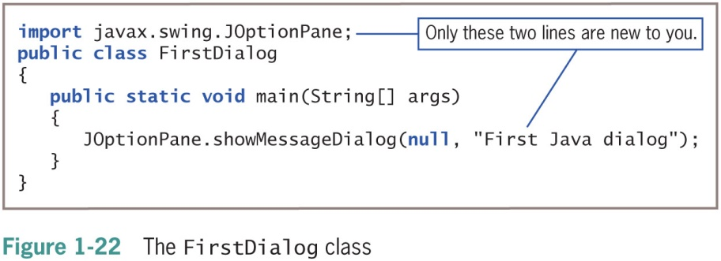
Creating a Java Application that Produces GUI Output (2 of 3)

Slide 46
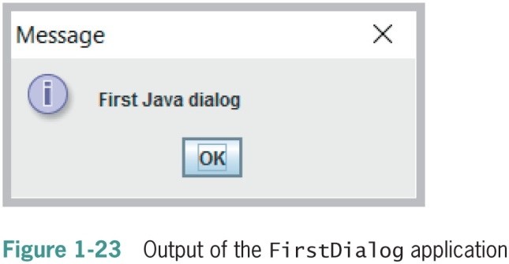
Creating a Java Application that Produces GUI Output (3 of 3)

Slide 47
Finding Help
Java API
Also called the Java class library
Provides prewritten information about Java classes
FAQs on the Java Web site
Java Development Kit (JDK)
A software development kit (SDK) of programming tools
Free to download

Slide 48
Don’t Do It
Don’t forget the file’s name must match the class name
Don’t confuse these terms:
Parentheses, braces, brackets, curly braces, square brackets, and angle brackets
Don’t forget to end a block comment
Don’t forget that Java is case sensitive
Don’t forget to end every statement with a semicolon
Do not end class or method headers with a semicolon
Don’t forgot to recompile when making changes
Don’t panic when you see a lot of compiler error messages
Don’t assume your program is perfect when all compiler errors are eliminated.

Slide 49
Summary (1 of 3)
Computer program
A set of instructions that tells a computer what to do
Object-oriented programs
Classes
Objects
Applications
Java Virtual Machine (JVM)
A standardized hypothetical computer
Everything in a Java program must be part of a class

Slide 50
Summary (2 of 3)
Access specifier
A word that defines circumstances under which a class can be accessed
All Java applications must have a method named main()
Program comments
Nonexecuting statements
Add to a file for documentation
javac
A compile command

Slide 51
Summary (3 of 3)
java
An execute command
JOptionPane
A GUI
Provides methods for creating dialogs

